Slide 1
ID: 222902036 Name:MD. Sohan Millat Sakib

Slide 2
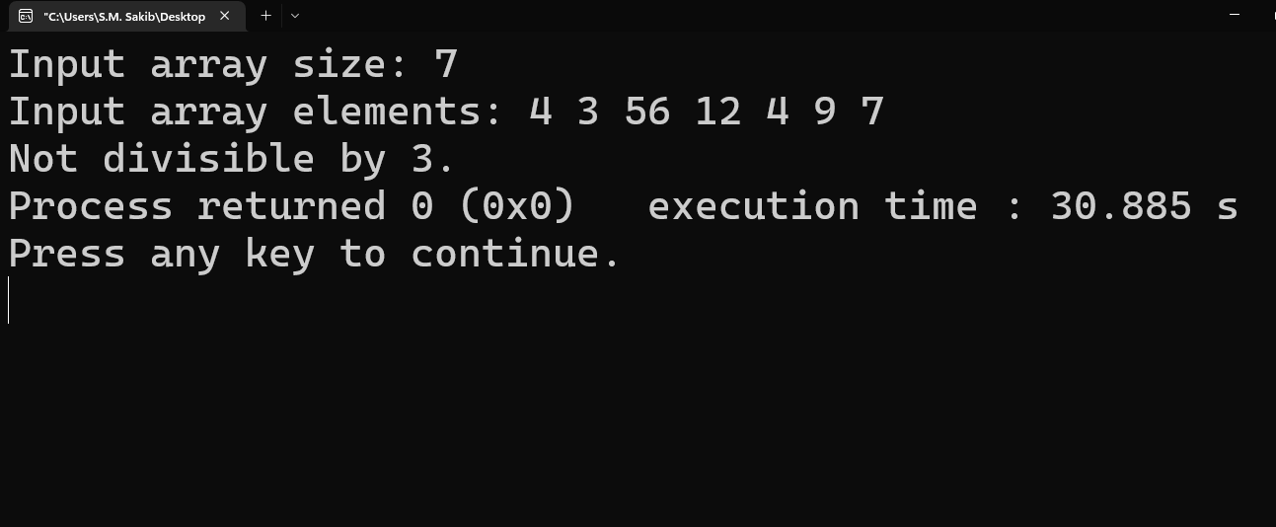
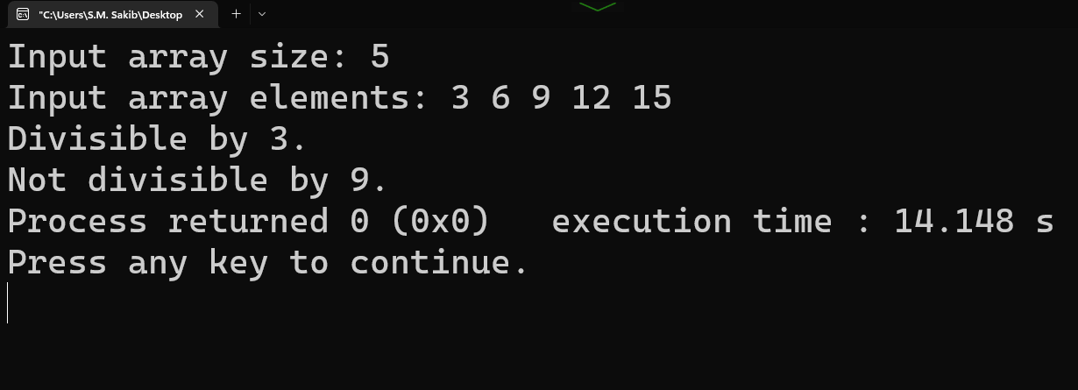
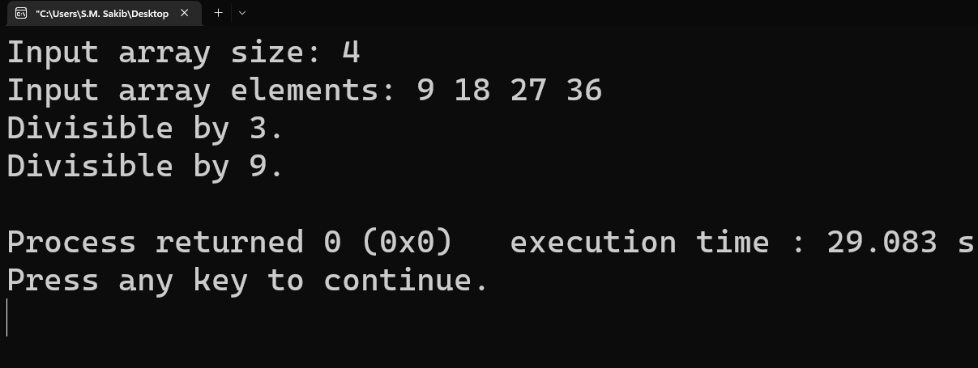
Output of 1

Slide 3


Output of 2

Slide 4
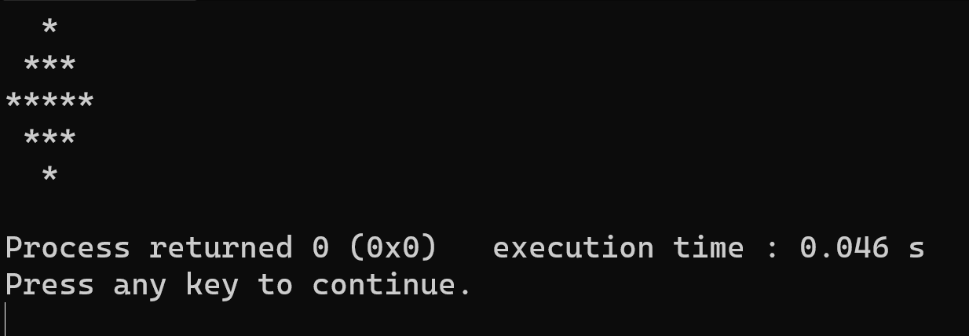
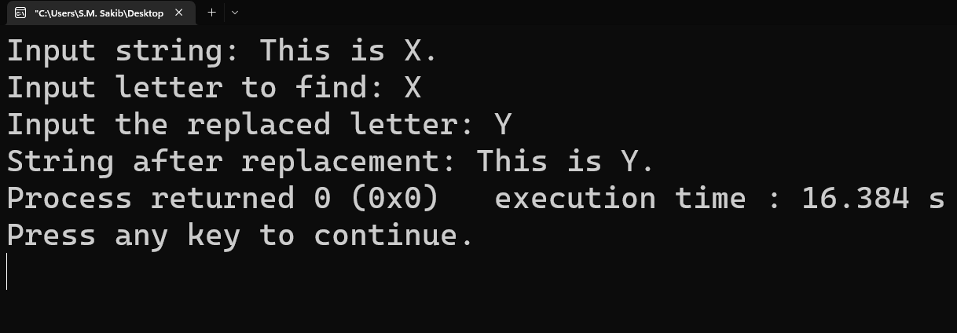
Output of 3
Output of 4

Slide 5


Output of 5

